Slide 1
Langugage Used :- The Language is Used to make this system is Python with help of different modules in it.
The source code Editor we are going to use is Visual Studio Code.
Proposed System Feature
. Python provides a large standard library which includes areas like internet protocols, string operations, web services tools and operating system interfaces. Many high use programming tasks have already been scripted into the standard library which reduces the length of code to be written significantly.
2. Python has clean object-oriented design, provides enhanced process control capabilities, and possesses strong integration and text processing capabilities and its own unit testing framework, all of which contribute to the increase in its speed and productivity. Python isconsidered a viable option for building complex multiprotocol network applications.
3 . A text-to-speech (TTS) system converts normal language text into speech. Synthesized speech can be created by concatenating pieces of recorded speech that are stored in a database. The output is given in the form of speech.
4. This Voice Assistant can benefit large number of users with universal eyes free and hands free voice control of their mobile devices. Its framework may help to shape future voice control devices.

Slide 2
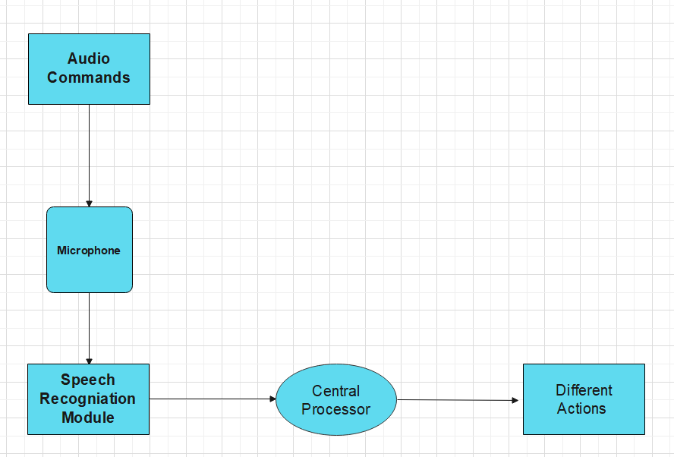
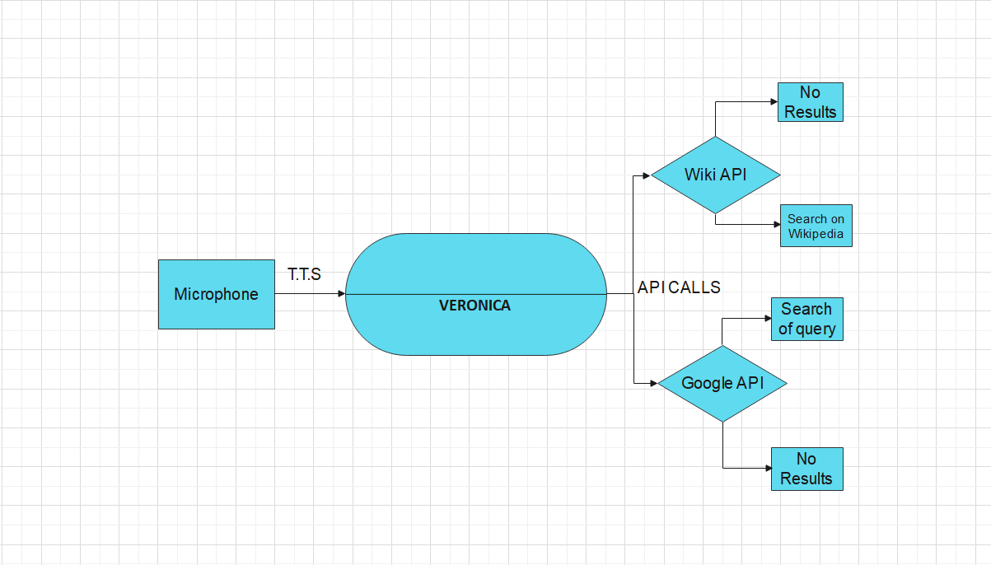
SYSTEM DESIGN AND IMPLEMENTATION
z
Figure.1 Workflow of the Smart Assistant
Figure2. API calls of V.E.R.O.N.I.C.A

Slide 3
Proposed Model of Smart Assistant
The model consists of user input through microphone to accept commands from the user. These commands are then go through Speech Recognition, it is the ability of a machine or program to
identify words and phrases
In spoken languages and convert them to a machine- readable format. On these input Natural Language Processing is applied, it is a field which is created by amalgamating computer science and artificial intelligence. Using NLP, we are concerned with interactions between computers and human natural languages. Then the AI check whether it is a question or an action, if it is a action than the action is performed by the voice assistant and acknowledgment is given to the user via a synthesis voice or if it is a question than it is search in dialog box or knowledge base and then response via a synthesis voice to the user. Our Voice assistant uses google text-to-speech API to understand all the words spoken by the user, and based on certain conditions that satisfy being a command the voice assistant sends responses to the user.
A. Recognition of speech: The device converts speech input to text using Google's online speech recognition algorithm. The voice input Users can access texts from the unique corpora arranged on the computer network server at the knowledge center, which are briefly kept within the system before being forwarded to the Google cloud for speech recognition. After that, the central processor receives the corresponding text and feeds it to it.
B. Python Backend The python backend parses the voice recognition module's output to determine if the command or speech output is an API Call, Context Extraction, or Supervisor Call instruction. The output is then sent back to the python backend to provide the user with the desired results.

Slide 4
C. Application Programming Interface (API) Calls API stands for Application Programming Interface. An API is a software interface that allows two apps to communicate with one another. To put it another way, an API is the messenger that delivers your request to the provider you're seeking it from, and then returns the result to you.
D. Context Extraction: Context extraction (CE) is the task of automatically extracting structured information from unstructured and/or semi-structured machine-readable documents. In most of the cases this activity concerns processing human language texts by means of tongue processing (NLP). Recent activities in multimedia document processing like automatic annotation and content extraction out of images/audio/video might be seen as context extraction TEST RESULTS
E. Systems Calls: In computing, a supervisor call instruction is that the programmatic way during which a computer virus requests a service from the kernel of the OS it's executed on. This may include hardware-related services (for example, accessing a tough disk drive), creation and execution of latest processes, and communication with integral kernel services like process scheduling. System calls provide an important interface between a process and therefore the OS.
F. Text-To-Speech: The capacity of computers to read text aloud is referred to as text-to-speech (TTS). A TTS Engine turns transcription into a phonemic representation, which is subsequently translated into waveforms. will be played as a sound Third-party publishers offer TTS engines in a variety of languages, dialects, and specialist vocabularies. Python, as we all know, is a good language for script writers and developers

Slide 5
ADVANTAGEOUS FEATURES
. Voice-enabled, voice control, voice interaction, voice queries.
2 . Natural language interaction. Commands. …
3 . Find information. Weather. …
4 . Complex Calculations….
. Answer questions. Digital encyclopedia.
. Make recommendations.
. Media Control
. Better System Interactive Experience
. Handfree Access Through Out The System
. Face Detection and Facial recognation Features.

Slide 6
CONCLUSION AND FUTURE SCOPE
This AI will help to work more easily on through your voice command and further with some upgradations it’s further used for securing data and its capable of doing complex calculation at instant
Advanced security features. In this, the voice authentication technology can be implemented for more security. More advancement is possible like operating on various tones or accents from different regions that mean it should be able to perform operations on various voice tones and accents. Further modifications are possible like learning the answer of questions that are not known by the voice assistant and replying whenever next time the same question is put up by the user

Slide 7
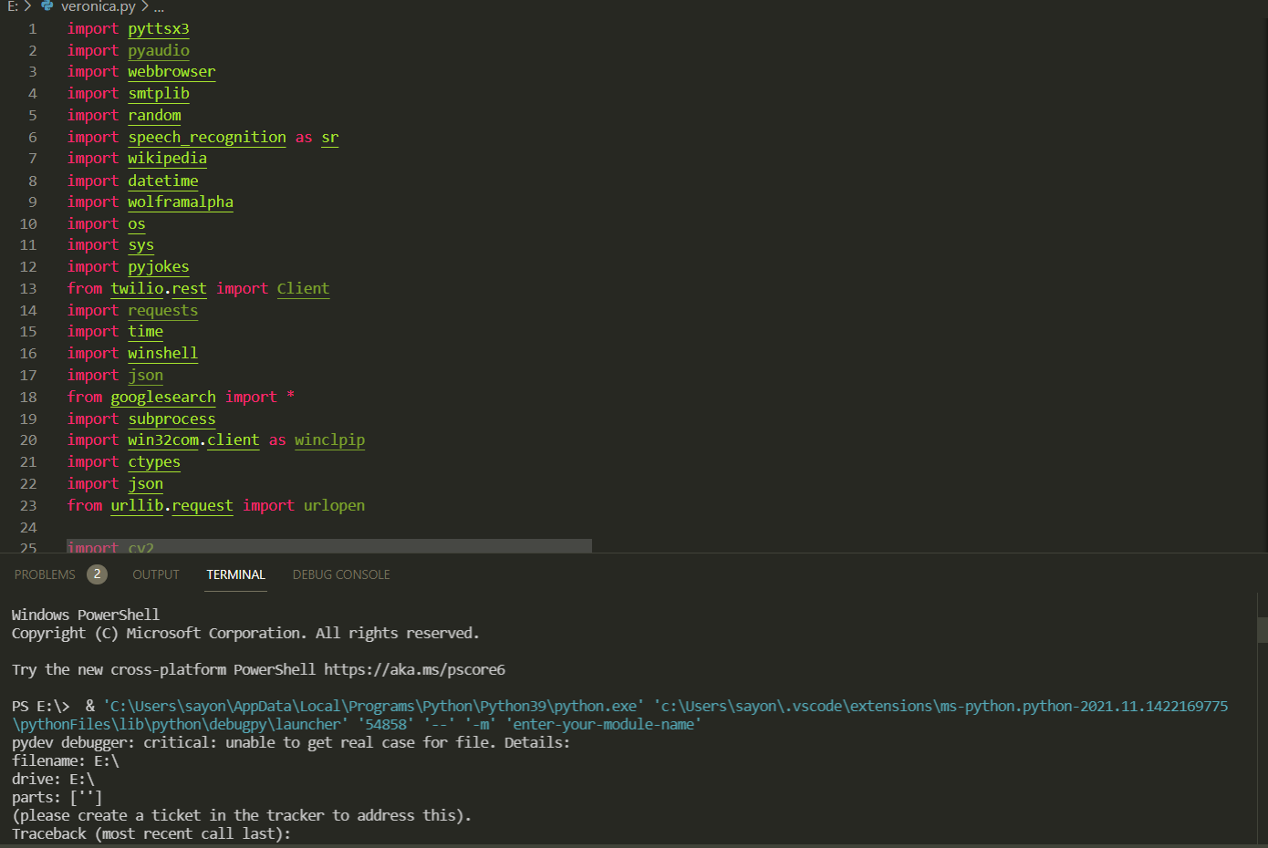
Outcomes
This project is frequently enhanced by including voice commands with Google is a search engine. Improved speech recognition, allowing the user to comprehend what is being spoken may obtain prompt output and applications such as locking or unlocking the computer based on the user's requests The major goal of our Smart Assistant Veronica is to improve User Interference with the user.
Step1. Installing the modules that are requires to the system to perform functionalities and then using speech recognition and by importing other modules one can makes the assistant functional
Figure 4. Installation and import of modules in the Python IDE

Slide 8
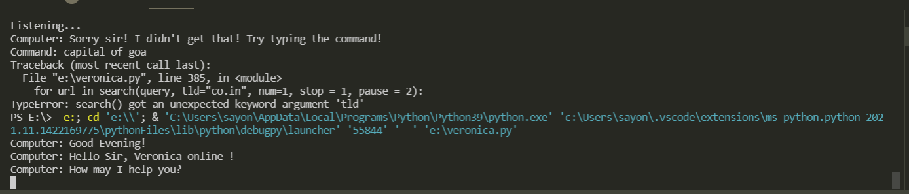
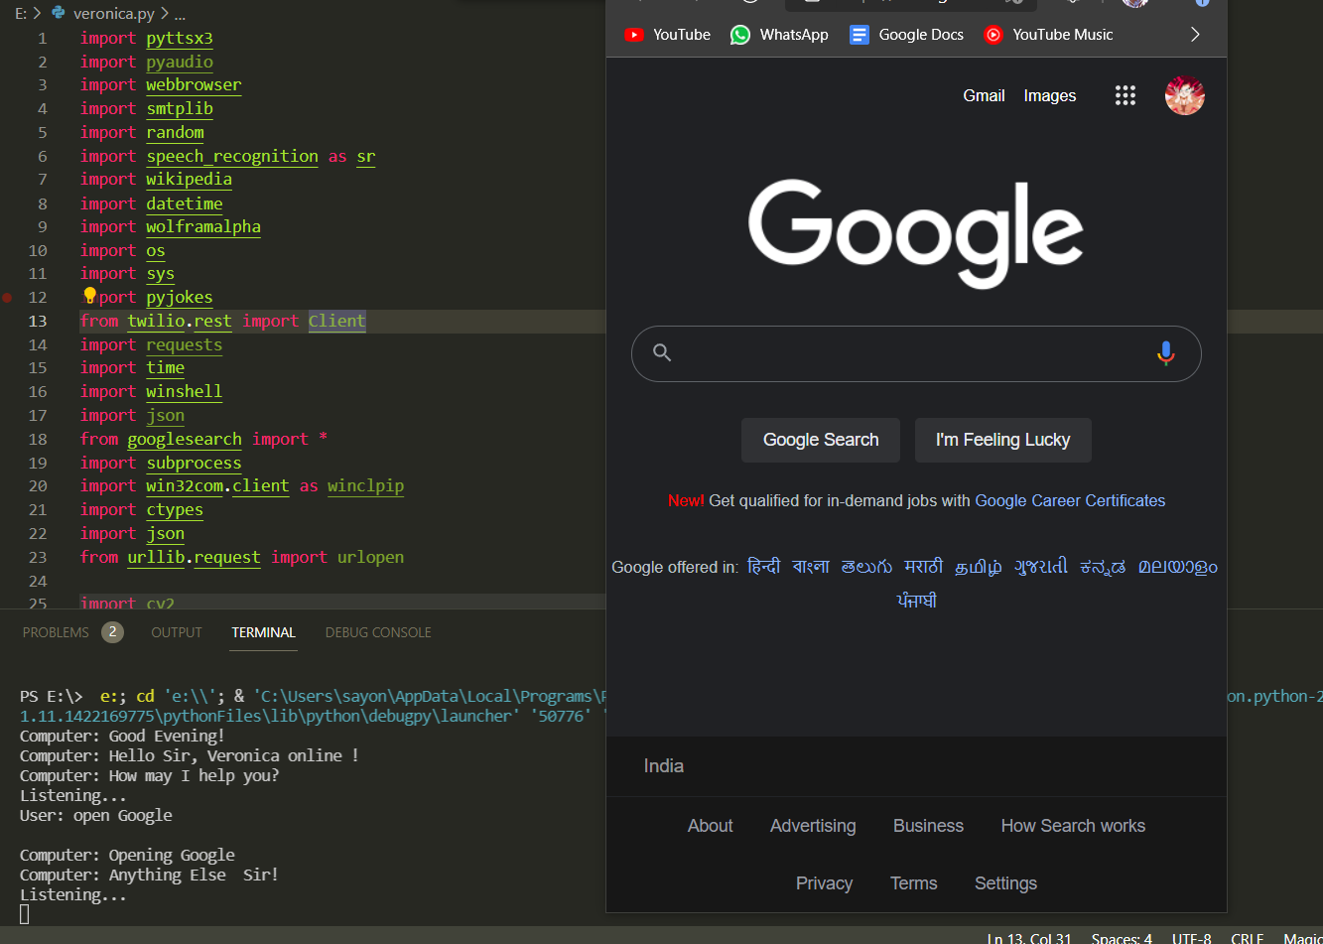
Step 2. Run the programmer and then greet the user according to the time takes the user input and work accordingly to command
Figure 5. Initializing the command of the user
Step 3. The system will follow the command of the user and works accordingly to it.
Figure 6.Following the user’s command

Slide 9
THANK YOU

